Slide 1



GooAQ: Open Question Answering with Diverse Answer Types
Daniel Khashabi, Amos Ng, Tushar Khot, Ashish Sabharwal
Hannaneh Hajishirzi, Chris Callison-Burch
EMNLP-Fingings’21
Notes:
Hi, I am Daniel Khashabi and this is a short video presentation on our EMNLP-Findings paper, "GOOAQ: Open Question Answering with Diverse Answer Types"
This is a joint work with collaborators from Allen Institute for AI, University of Washington and University of Pennsylvania.

Slide 2
State of “Open” Question Answering
“Open” question answering [Roberts et al., 2020; Lewis et al., 2021]
Also referred to as open-response, open-domain, or direct answer QA
Existing work
Built datasets and models for answering questions without specified context
NQ-open [Lee et al., 2019]
TriviaQA [Joshi et al., 2017]
ARC-DA [Bhakthavatsalam et al., 2021]
ELI5 [Fan et al., 2019]
how many calories burned 30 minutes crossfit?
LM
260 calories
short answers
long answers
Notes:
Consider a setup where, a natural language question is given to a language model and the model has to use internal/external knowledge to provide an answer for this question.
There has been a lot of work recent work on this setup:
Here are several notable datasets for this setup.
The limitation with the all these studies is that they often focus on niche answer types, mainly short responses and, in a few cases, long responses.

Slide 3
Open QA: Diversity of Answers
what is the difference between an assignment and a delegation?
The difference is that an assignment can't increase another party's obligations. Delegation, on the other hand, ….
snippet
what are the ingredients used in making black soap?
LM
{ 9 oz Coconut Oil., 20 oz Palm Oil., 3.5 oz Shea Butter., ...}
collection
what is the gravitational force
of uranus?
8.87 m/s²
short: knowledge
what is the square feet of an acre?
43560
short: unit conv
what is the time difference between south africa and mauritius?
Time-conversion
short: time conv
Notes:
In contrast, many of the everyday questions that humans deal with and pose to search engines, require a more diverse set of response types
These can be:
Questions that require multi-sentence description (a snippet)
Questions that ask for a collection of items such as ingredients or of steps towards a goal (‘how to’), etc.
Even when the answer is short, it can have rich types, e.g., unit conversion, time zone conversion, or a variety of knowledge look-up.
Such answer type diversity is not represented in the existing datasets → and that’s where our contribution comes along.

Slide 4

GooAQ: Overview
Introducing GooAQ
Open QA benchmark
Contains 3 million questions
Questions with a variety of types
All collected using a coherent process
Answer types | Count
Short answers | 275k
↳ unit conversion | 45k
↳ time conversion | 2.5k
↳ knowledge | 32k
↳ snippet (short) | 196k
Snippet | 2.7M
Collection | 329k
Overall | 3.1M
Notes:
Motivated by this, we introduce GooAQ,
which contains questions with a variety answer types within a unified dataset, collected using the same, coherent process.
Contains 3 million questions with snippet, or collection answers, a variety of short answer types.
Let me give a brief description of we collected GooAQ.

Slide 5


GooAQ: Overview
Introducing GooAQ
(a) Question Extraction
(b) Answer Extraction
similar to Berant et al. 2013
Notes:
In the first stage, we collect the questions:
GOOAQ questions are automatically mined from Google's autocomplete feature.
We start with a seed set of question terms (e.g., ‘who’, ‘where’,.)
We bootstrap based on this set, by repeatedly querying prefixes of previously extracted questions, in order to discover longer and richer sets of questions.
Since the auto-complete feature reflects the space of popular questions posed by Google users, we hypothesize, that our extracted questions represent popular queries of realworld interest.
After extracting popular Google questions, we extract their answers from Google search results.
Our extracted questions, because of their popularity, often trigger ‘answer boxes’ in the search results, containing responses deemed best by Google, which we extract as the answers to the questions.
Subsequently we conduct a human evaluation on our collected questions and answers, where our annotators deemed them to be of high quality.

Slide 6
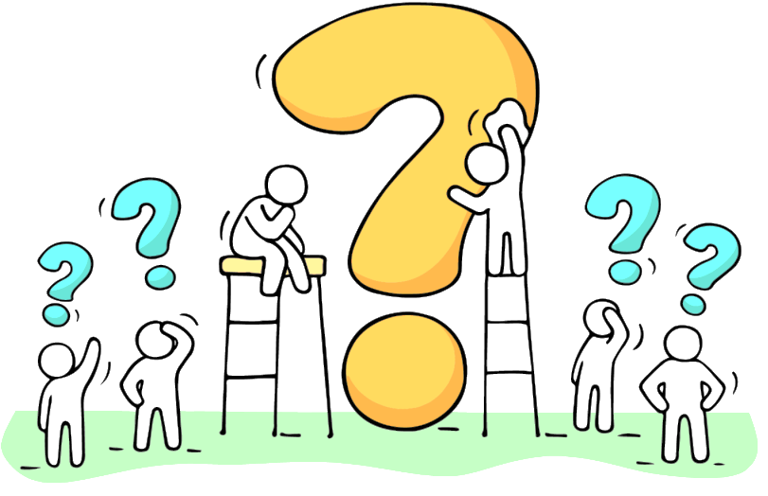
GooAQ: Overview
Introducing GooAQ
Open QA benchmark
Contains 3 million questions
Questions with a variety of types
All collected using a coherent process
Answer types | Count
Short answers | 275k
↳ unit conversion | 45k
↳ time conversion | 2.5k
↳ knowledge | 32k
↳ snippet (short) | 196k
Snippet | 2.7M
Collection | 329k
Overall | 3.1M
Differences across different answer types?
Notes:
Now, how do we use GooAQ?
Obviously, one can use GooAQ as a resource in a variety of ways.
In our case, we use it to better understand different answer types.
GooAQ, by virtue of supporting various types of answers, GOOAQ enables a quantitative study of the inherent differences among answer types.

Slide 7
Questions: Answer Type Behavior
Whether different answer types:
(Q1) benefit similarly from pre-training?
(Q2) benefit similarly from labeled data?
(Q3) benefit similarly from larger models?
Differences across different answer types?
Notes:
In particular, we interested in understanding whether different answer types:
(Q1) benefit similarly from pre-training?
(Q2) benefit similarly from labeled data?
(Q3) benefit similarly from larger models?
To understand these, we conduct a series of controlled experiments.
Here I won’t get into the details of how these studies were done (you can check the paper for the details).
But let me summarize what we found!

Slide 8
Empirical Findings: Summary
Whether different answer types:
(Q1) benefit similarly from pre-training?
(Q2) benefit similarly from labeled data?
(Q3) benefit similarly from larger models?
short
😒
✅
✅
snippet
✅
😒
✅
collection
✅
😒
✅
Pre-training is surprisingly effective on the snippet and collection answers.
Labeled data is more helpful for short answer questions.
Model size is
more helpful for
snippet & collection answers.
Notes:
Q1: On the question of whether different answer types benefit similarly from pre-training:
While pretraining has little benefit for short response questions, it is key for generating snippet and collection responses.
We hypothesize this is because response fluency and coherence are more important in long answer generation.
Q2: Regarding the value of labelled data, we observe the opposite trend:
short response questions benefit consistently from increasing amounts of supervised (labeled) data,
whereas both snippet and collection response questions show minimal gains when given several orders of magnitude more training examples
Q3: Lastly, on the benefit of model size,
we find larger models to be more effective in all cases as expected, but the gains are much more pronounced for snippet and collection response generation (20+%) as compared to short responses (5-10%), under human evaluation.
Such discrepancies in behavior of different answer types with respect to parameters of model design is new,
and we hope to see more follow up work in this direction.

Slide 9
Summary
GooAQ: a collection of 3 million question-answer pairs with a diverse set of answers.
Benchmark state-of-the-art models on different answer types.
Valuable resource for training models.
Code & Data: https://github.com/allenai/gooaq
Notes:
In summary:
We present GOOAQ, a collection of 3 million question-answer pairs with a diverse set of answers, along with a crowdsourced assessment of its quality.
We benchmark state-of-the-art models on GOOAQ, both in terms of automatic and human judgments, and observe remarkable differences in how models behave on different answer types.
Lastly, we find GOOAQ to be a valuable resource for training models.
for example, in the paper we demonstrate GOOAQ is valuable for training models for ELI5, another long-answer benchmarks.
GooAQ is public:
Give it a look and let us know what you find out.
Thank you!

Slide 10
Experimental Setup
We fine-tune T5 [Raffel et al., 2020]
T5
11B
T5
small
Answer types | Count
Short answers | 275k
↳ unit conversion | 45k
↳ time conversion | 2.5k
↳ knowledge | 32k
↳ snippet (short) | 196k
Snippet | 2.7M
Collection | 329k
T5
11B
T5
small
T5
11B
T5
small
Notes:
To understand the contribution of pre-training, (Q1), we train the powerful T5 language model (Raffel et al., 2020) on GOOAQ with a small amount of labeled data.
TODO: say different sizes of data

Slide 11
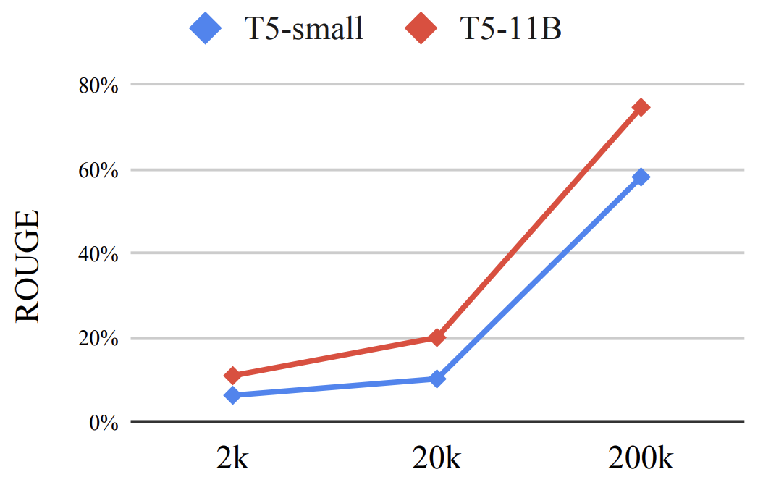
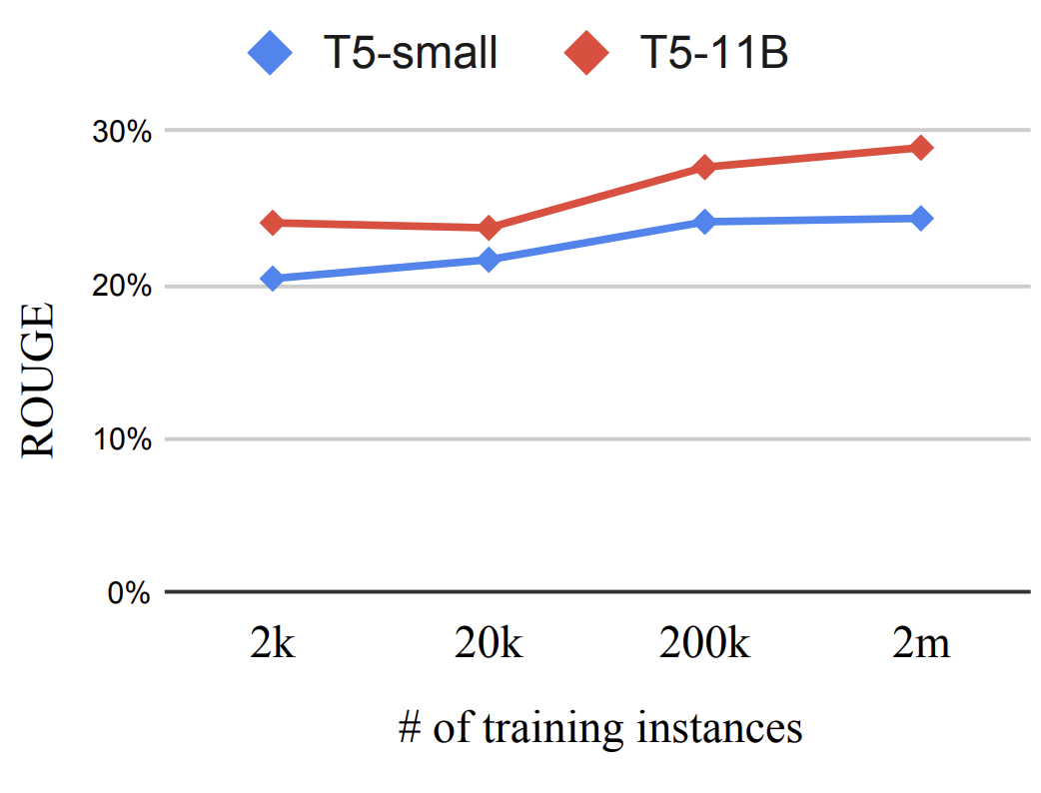
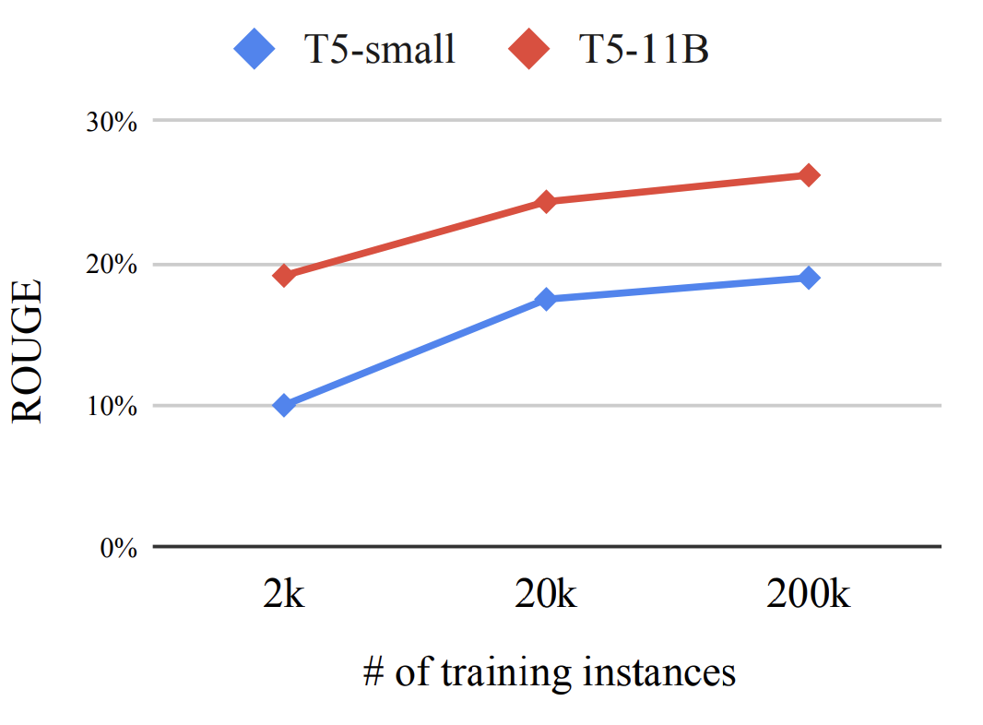
Experimental Setup
T5
11B
T5
11B
T5
11B
T5
small
T5
small
T5
small
Notes:
To understand the contribution of pre-training, (Q1), we train the powerful T5 language model (Raffel et al., 2020) on GOOAQ with a small amount of labeled data.
Q1: While LMs struggle, as expected, in this setting on short response questions, they perform surprisingly well in generating snippet and collection responses.
We hypothesize this is because response fluency and coherence have a much higher weight in such questions, and these factors remarkably benefit from the LM pre-training objective.
Q2: Regarding the value of labelled data, (Q2), we observe the opposite trend:
short response questions benefit consistently from increasing amounts of supervised (labeled) data,
whereas both snippet and collection response questions show minimal gains (e.g., only 5-10% improvement when going from 2k training examples to 200k or even 2 million).
Lastly, on the benefit of model size, (Q3), we find larger models to be more effective in all cases as expected, but the gains are much more pronounced for snippet and collection response generation (20+%) as compared to short responses (5-10%), under human evaluation.

Slide 12
Experimental Setup
T5
11B
T5
11B
T5
11B
T5
small
T5
small
T5
small
Notes:
To understand the contribution of pre-training, (Q1), we train the powerful T5 language model (Raffel et al., 2020) on GOOAQ with a small amount of labeled data.
Q1: While LMs struggle, as expected, in this setting on short response questions, they perform surprisingly well in generating snippet and collection responses.
We hypothesize this is because response fluency and coherence have a much higher weight in such questions, and these factors remarkably benefit from the LM pre-training objective.
Q2: Regarding the value of labelled data, (Q2), we observe the opposite trend:
short response questions benefit consistently from increasing amounts of supervised (labeled) data,
whereas both snippet and collection response questions show minimal gains (e.g., only 5-10% improvement when going from 2k training examples to 200k or even 2 million).
Lastly, on the benefit of model size, (Q3), we find larger models to be more effective in all cases as expected, but the gains are much more pronounced for snippet and collection response generation (20+%) as compared to short responses (5-10%), under human evaluation.

Slide 13

Q1 (benefit of pre-training):
Model pre-training is surprisingly effective on the snippet and collection answers.
Q2 (benefit of labeled data):
Labeled data is more helpful for short answer questions.
Q3 (benefit of model size):
Model size is more helpful for snippet and collection answer questions.
Notes:
To understand the contribution of pre-training, (Q1), we train the powerful T5 language model (Raffel et al., 2020) on GOOAQ with a small amount of labeled data.
Q1: While LMs struggle, as expected, in this setting on short response questions, they perform surprisingly well in generating snippet and collection responses.
We hypothesize this is because response fluency and coherence have a much higher weight in such questions, and these factors remarkably benefit from the LM pre-training objective.
Q2: Regarding the value of labelled data, (Q2), we observe the opposite trend:
short response questions benefit consistently from increasing amounts of supervised (labeled) data,
whereas both snippet and collection response questions show minimal gains (e.g., only 5-10% improvement when going from 2k training examples to 200k or even 2 million).
Lastly, on the benefit of model size, (Q3), we find larger models to be more effective in all cases as expected, but the gains are much more pronounced for snippet and collection response generation (20+%) as compared to short responses (5-10%), under human evaluation.

Slide 14
Summary of Experiments
Fine-tune T5 [Raffel et al., 2020]
Extreme sizes: “11B” and “small”
Different amounts of supervision:
2k, 20k, 200k
Evaluation: automatic and human
Answer types | Count
Short answers | 275k
↳ unit conversion | 45k
↳ time conversion | 2.5k
↳ knowledge | 32k
↳ snippet (short) | 196k
Snippet | 2.7M
Collection | 329k
Notes:
To do so, we fine-tune generative pre-trained language models (LMs) (Lewis et al., 2020; Raffel et al., 2020) on different subsets of GOOAQ, and ask whether models trained for different answer types:
To understand the contribution of pre-training, (Q1), we train the powerful T5 language model (Raffel et al., 2020) on GOOAQ with a small amount of labeled data.
TODO: say different sizes of data

Slide 15

Google answers
Idea: extract answer boxes provided by Google.
Challenge: what to query?
Use the queries from the previous section.
Challenge: How to extract the queries?
Option 1: use https://serpapi.com
Option 2: crawl Google!
Notes:
Now for the 2nd part of this presentation, I’m gonna switch gears a bit.
I’m gonna talk about a relevant endevor but it’s not completely continuation of the previous work.

Slide 16
Mining Google queries
Mined ~5M queries and saved their HTML pages
For each HTML page, we check if it contains an answer box.
If so, we extract them:
Question: …
Answer type: …
Short answers: …
Long answer: …

Slide 17
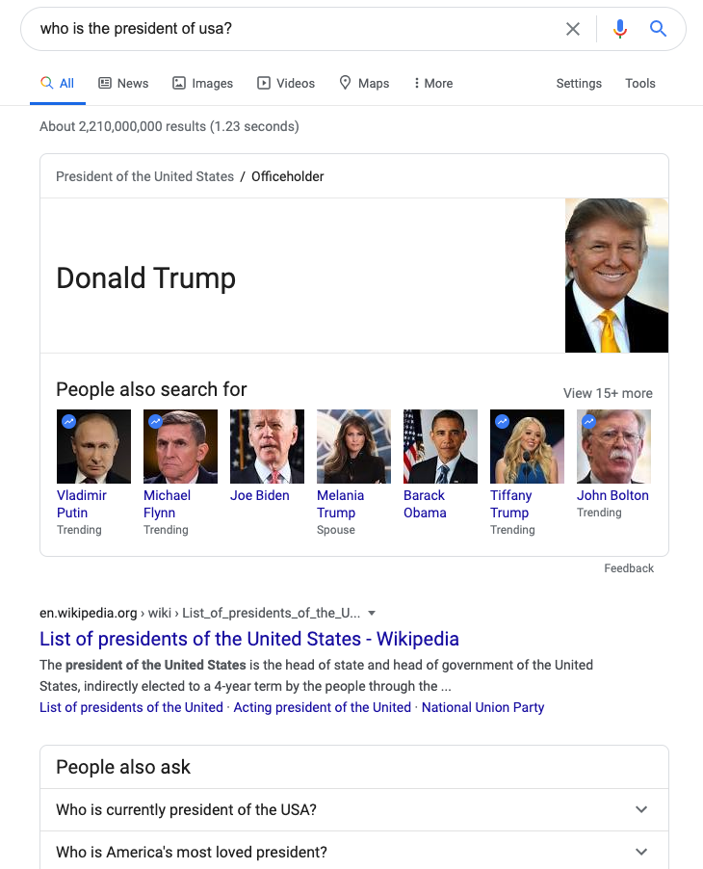
Google questions: examples
Question: who is the president of usa?
Answer type: short ans
Short answers: Donald Trump
Long answer: -

Slide 18

Google questions: examples
Question: do canadian citizens need a visa for ecuador?
Answer type: snippet
Short answers: -
Long answer: Ecuador tourist visa is not required for citizens of Canada for a stay up to 90 days. ...

Slide 19
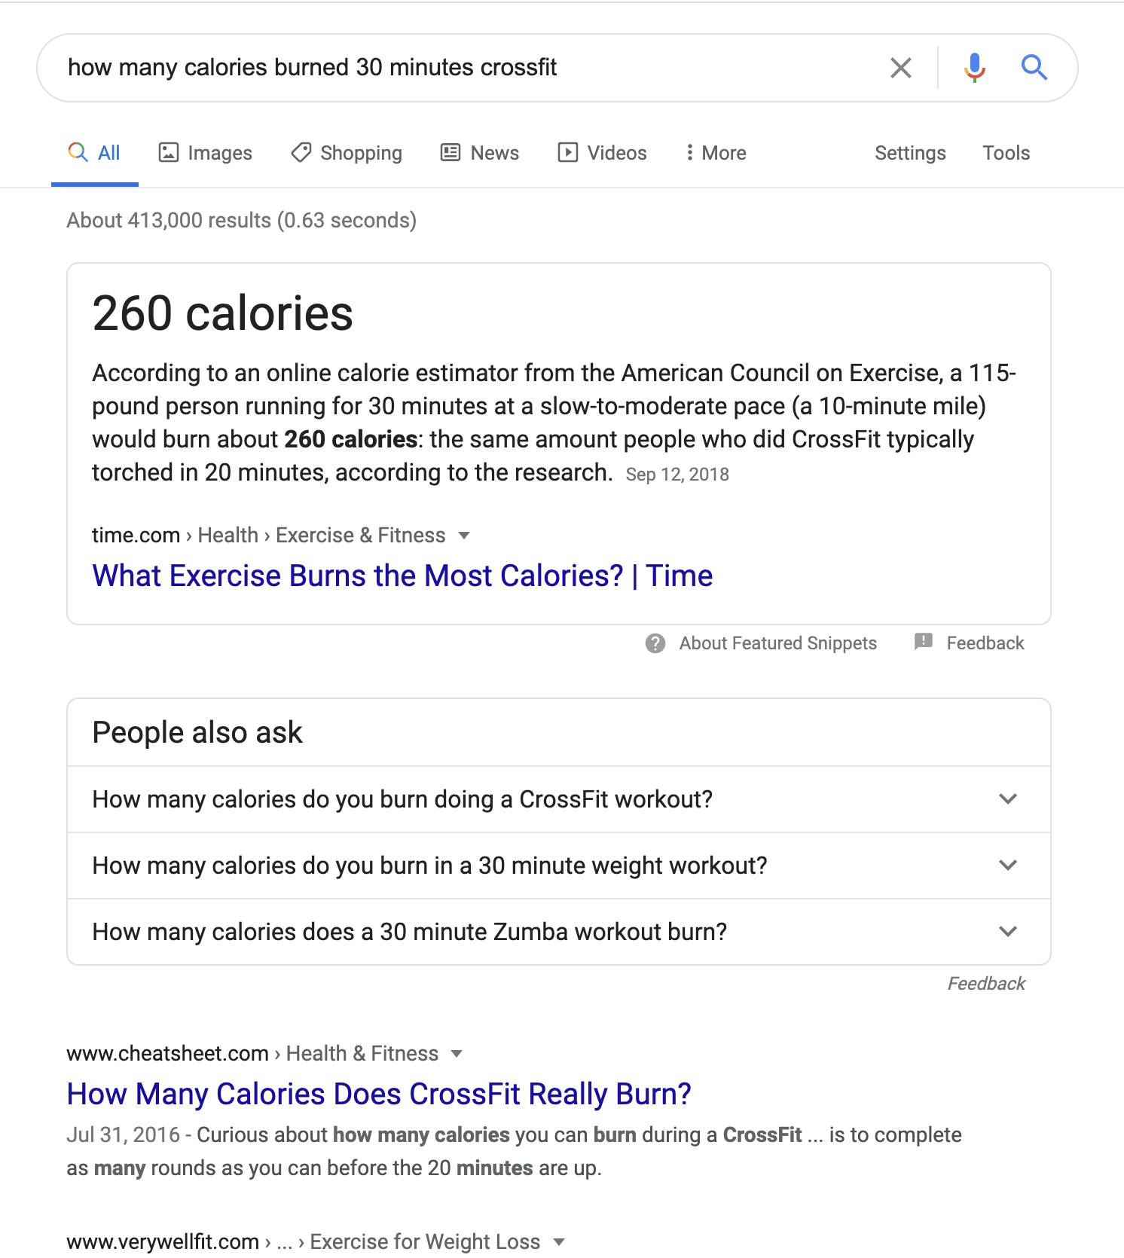
Google questions: examples
Question: how many calories burned 30 minutes crossfit?
Answer type: snippet w/ short answer
Short answers: 260 calories
Long answer: According to an online calorie estimator from the American Council on Exercise, a 115-pound person running for 30 minutes at a slow-to-moderate pace (a 10-minute mile) would burn about 260 calories: the same amount people who did CrossFit typically torched in 20 minutes, according to the research.

Slide 20

Google questions: examples
Question: what are the steps for decision making?
Answer type: list Short answers: -
Long answer: [ Step 1: Identify the decision You realize that you need to make a decision. ..., Step 2: Gather relevant information. ...
Step 3: Identify the alternatives. ...
Step 4: Weigh the evidence. ...
Step 5: Choose among alternatives. ...
Step 6: Take action. ...
Step 7: Review your decision & its consequences.
]

Slide 21
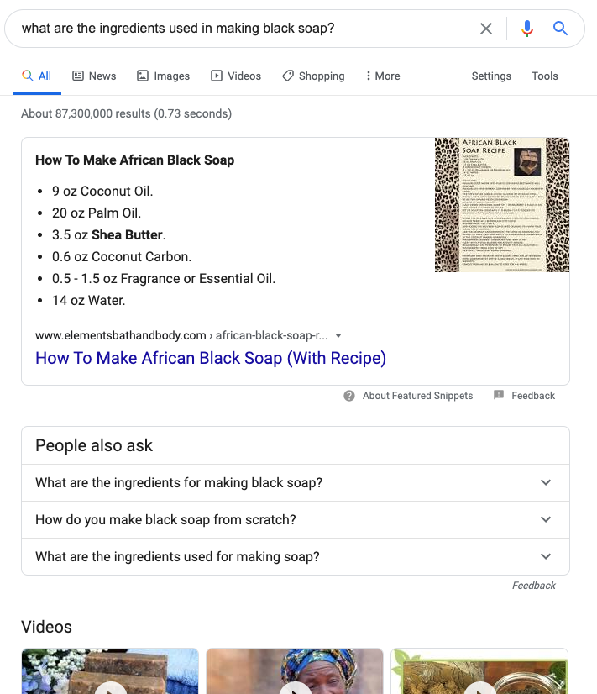
Google questions: examples
Question: what are the ingredients used in making black soap?
Answer type: set Short answers: -
Long answer: { 9 oz Coconut Oil., 20 oz Palm Oil., 3.5 oz Shea Butter., 0.6 oz Coconut Carbon., 0.5 - 1.5 oz Fragrance or Essential Oil. , 14 oz Water.
}

Slide 22
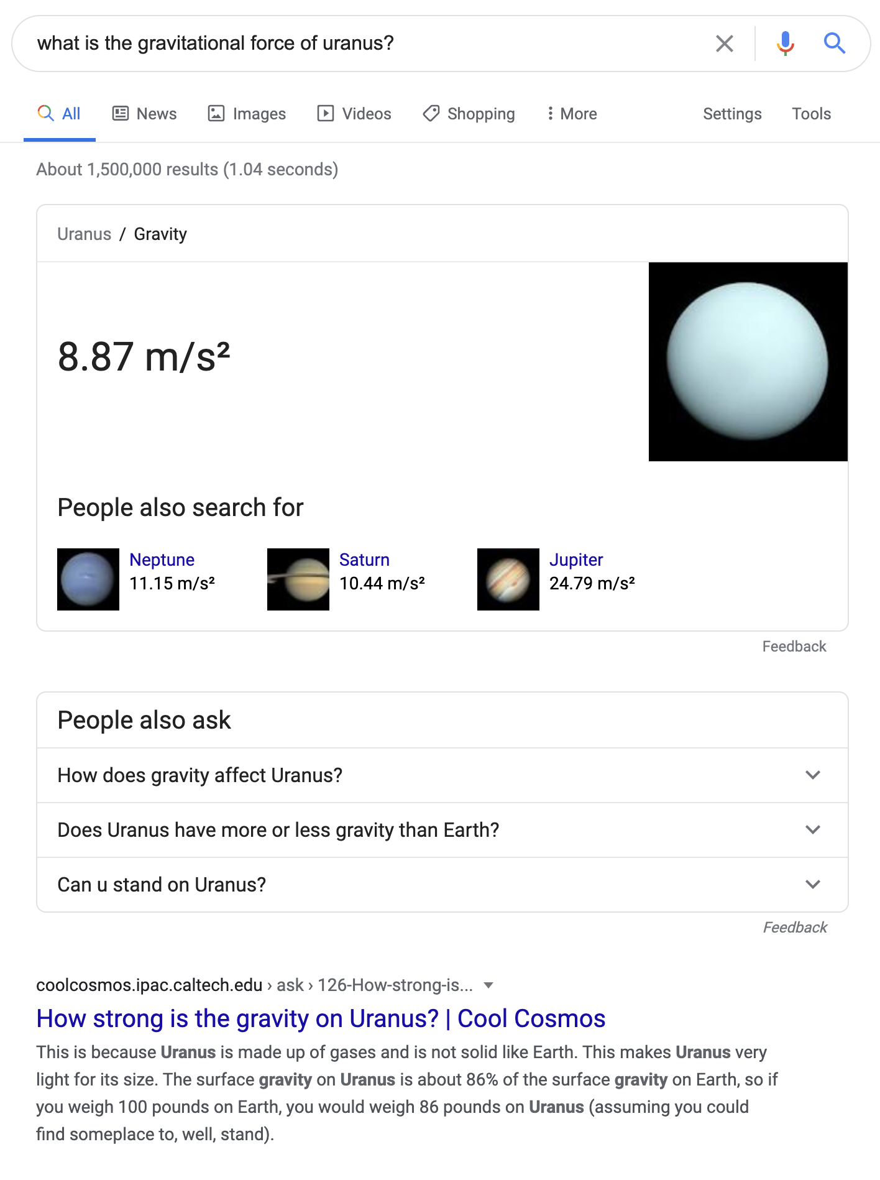
Google questions (knowledge)
Question: what is the gravitational force of uranus? Answer type: knowledge lookup Short answers: 8.87 m/s²
Long answer: --

Slide 23
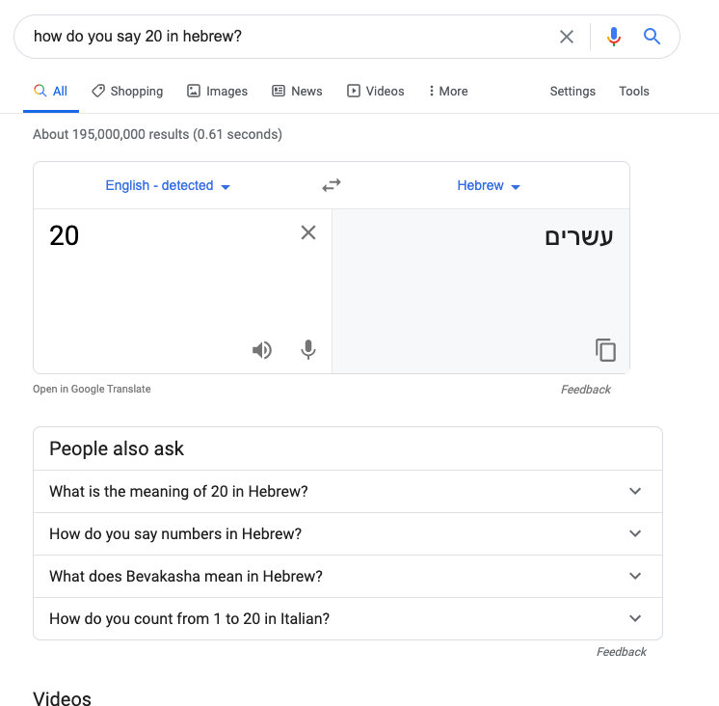
Google questions (translation)
Question: how do you say 20 in hebrew?
Answer type: translate
Short answers: עשרים
Long answer: -

Slide 24
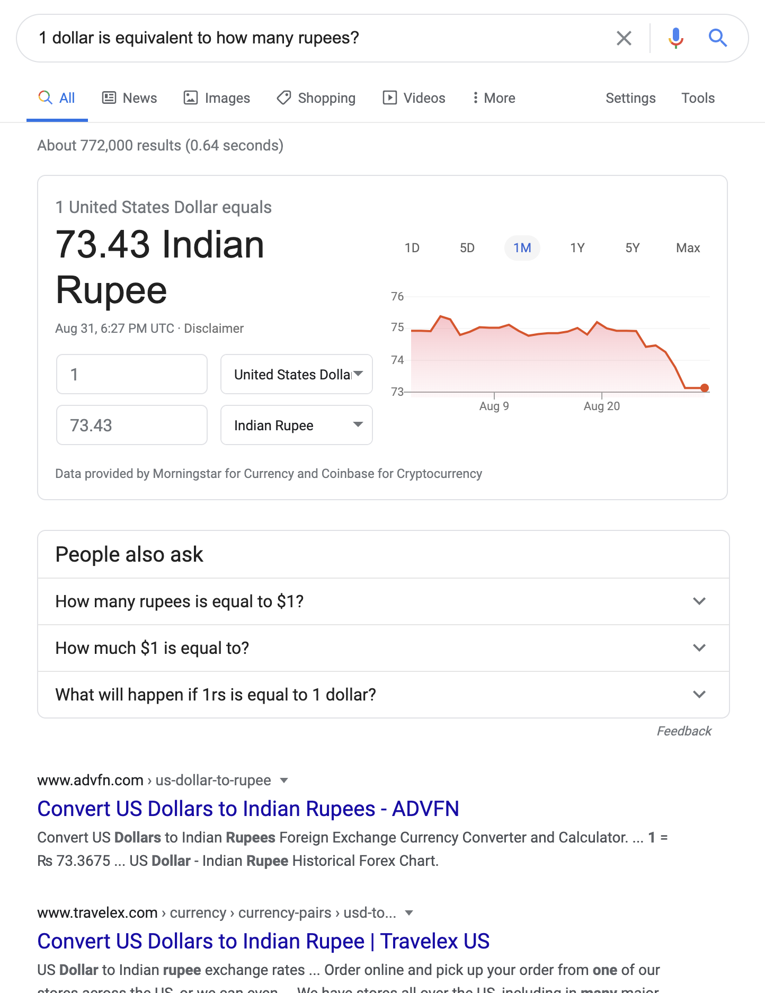
Google questions (currency conversion)
Question: 1 dollar is equivalent to how many rupees? Answer type: currency conversion Short answers: 75.52 Indian Rupe
Long answer: -

Slide 25
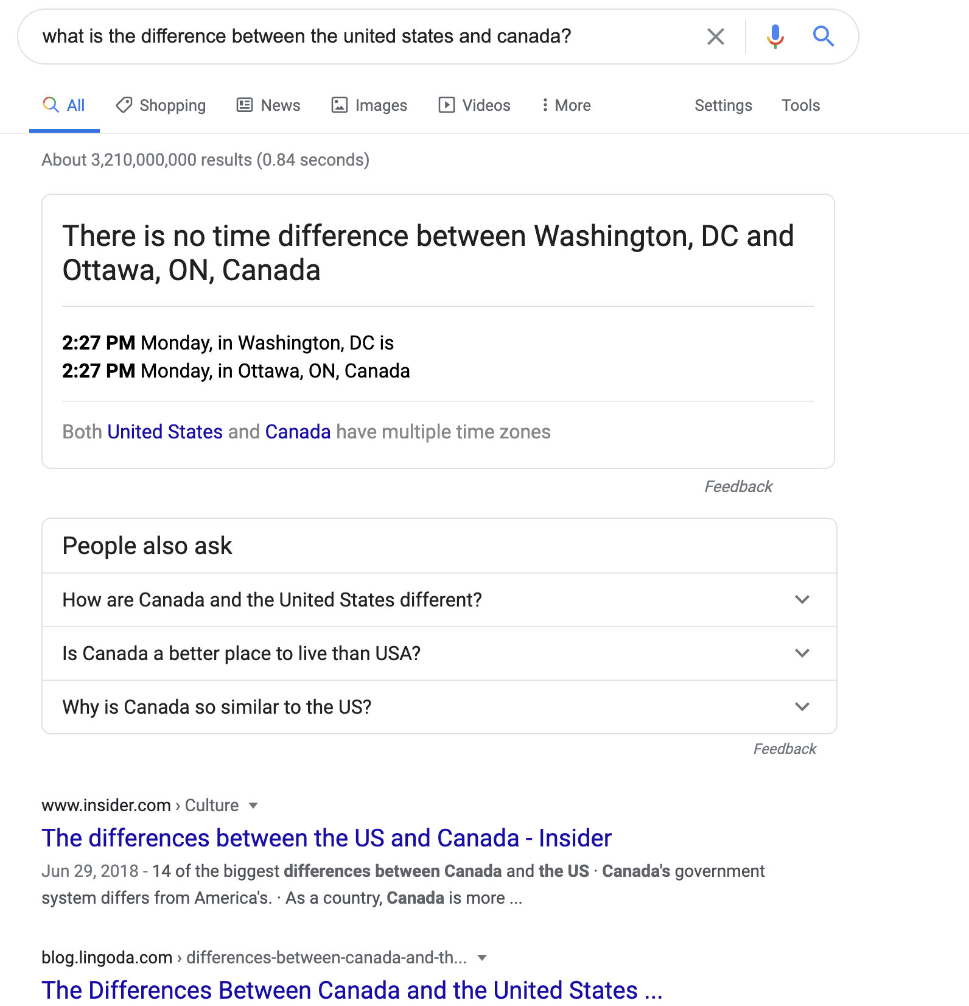
Google questions (time conversion)
Question: what is the difference between the united states and canada?
Answer type: time conversion Short answers: -
Long answer: There is no time difference between Washington, DC and Ottawa, ON, Canada

Slide 26
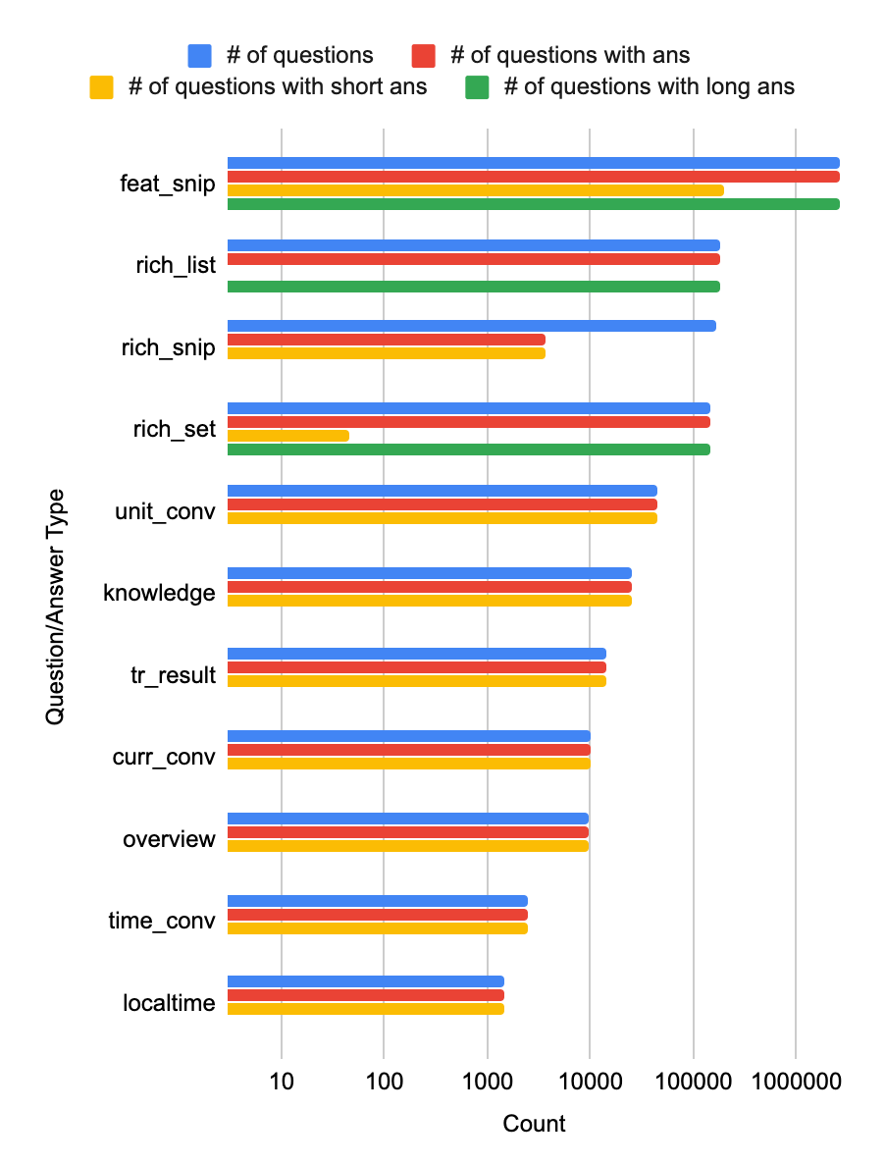
Google answers: question type statistics
# of questions with any answer: 3,146,425
# of questions with short answer: 308,697
# of questions with long answer: 3,033,898

Slide 27
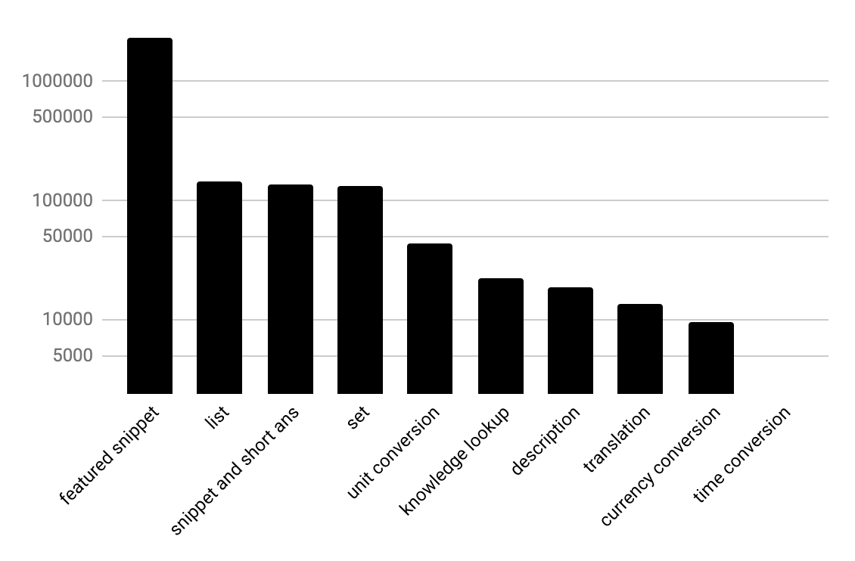
Google answers: question type statistics

Slide 28
Experiment #5
Take a 200k subset of Google Q/As with short answers (ans length < 5 words)
ID | Model | Trained on | Dev Score | Test Score
G | Giant (T5 – 11B) | NQ-open | 34.5 | 35.1
D0 | Dwarf (T5 – small) | NQ-open | 25.3 | 24.5
D1 | Dwarf (T5 – small) | Google Queries w/ G‘s predictions + NQ-open | 26.3 | 26.3
D2 | Dwarf (T5 – small) | Google Queries w/ G‘s predictions | 10.6
D3 | Dwarf (T5 – small) | Google Queries w/ G‘s predictions → NQ-open | 26.3 | 26.0
D4 | Dwarf (T5 – small) | Filtered Google Queries w/ G‘s predictions + NQ-open | 26.4 | 26.4
D5 | Dwarf (T5 – small) | Google Answers + NQ-open | 25.5 | 25.1

Slide 29
Questions for you
What other experiments we could have done here?
How else would you sell/use this resource?
There are a lot of data that can be used for procedural reasoning.
Could be used for pre-training a model for QA.

